Slide 1

Dominic Ross
CMU – III – OSS
OSS FFRDC Maturity Evaluation
Image
created by
Craiyon

Slide 2

Whats is a FFRDC?
Federally Funded Research and Development Centers (FFRDC) are private sector organizations tasked with assisting the U.S. government with long-term research and development.
Special access to government data and funding result in FFRDCs having to follow strict guidelines on what work they may accept.
Employees of FFRDCs are considered to be government contractors and must follow government policies.
FFRDCs must be free of organizational and employee conflicts of interest and cannot compete for work, except for the right to operate an FFRDC.
Image
created by
Craiyon

Slide 3
I started with a Lit Review to see how FFRDCs are different...
What was I looking for?
FFRDC OSS established procedures for release, contributions, licensing, management and maintenance.
Identify mature Industry OSS established procedures for release, contributions, licensing, management and maintenance.
Recorded with
OBS

Slide 4
I started with a Lit Review to see how FFRDCs are different...

Slide 5
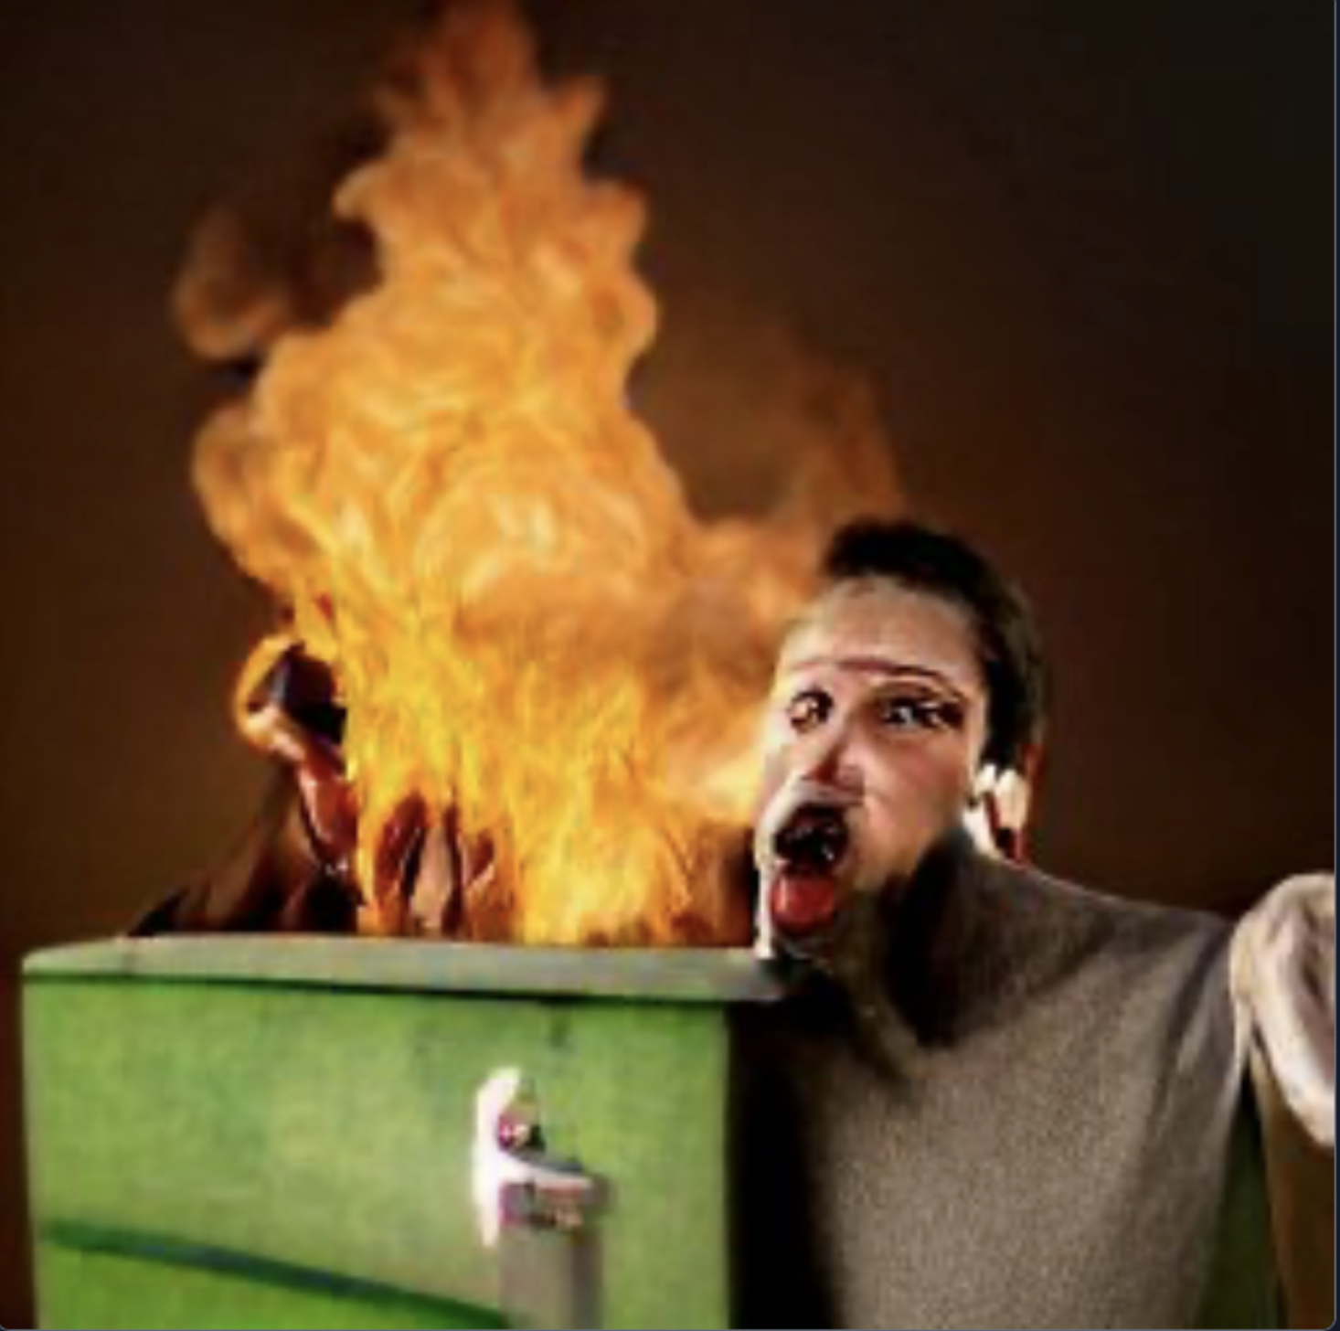
Just to be 100% Clear
This is a student project.
The information contained in this presentation is a general evaluation of how some FFRDC’s handle Open Source and is not meant to be a reflection or disclosure of information about any single FFRDC.
Participants come from a variety of FFRDCs.
The FFRDCs will never be named and I do not represent any FFRDC for this project.
This presentation should not be considered a statement or factual representation by any FFRDC. Again STUDENT PROJECT!
This presentation doesn’t represent the DoD either, in any way.
Did I mention this is a student project?
Please check with your own organization prior to implementing any recommendations.
Image
created by
Craiyon

Slide 6
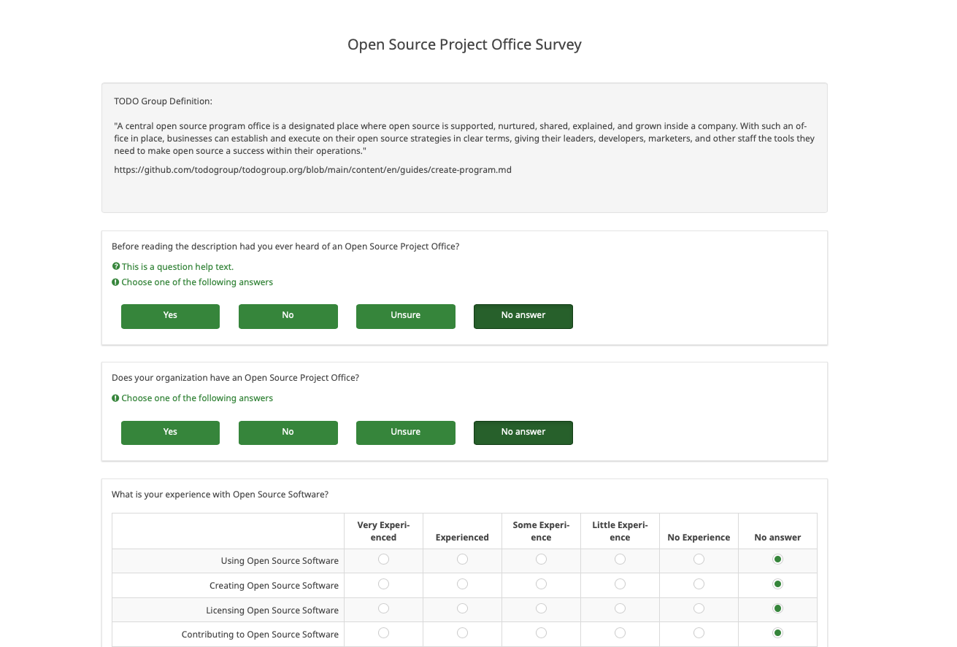
I made a survey.
8 Questions in length.
Evaluating individual OSS experience from FFRDC employees.
If they saw values in an OPSO in a FFRDC.
Employees also accessed the OSS maturity of FFRDCs they have worked with.
https://daross.limesurvey.net/593425?lang=en
Survey Created with
Limesurvey

Slide 7
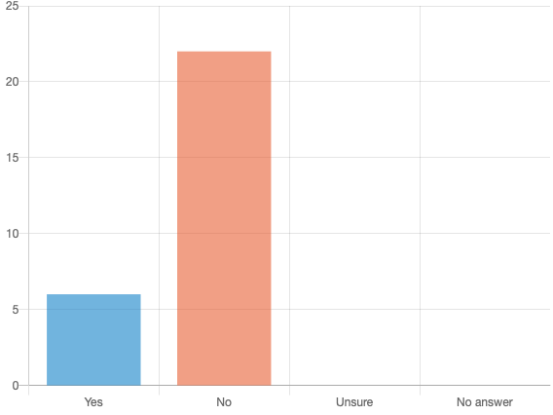
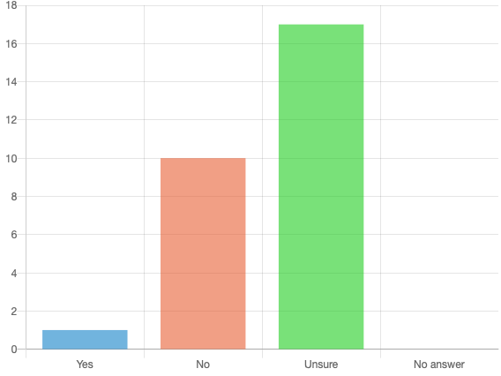
I ran a Anonymous survey.
Before reading the description had you ever heard of an Open Source Program Office?
Does your organization have an Open Source Project Office?

Slide 8
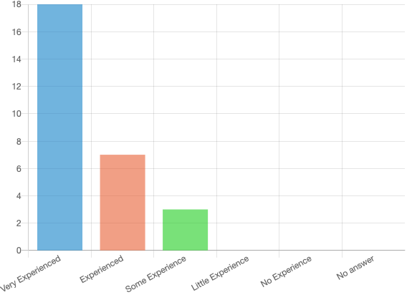
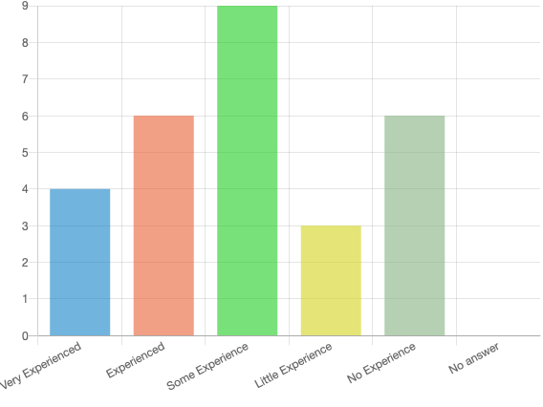
I ran a Anonymous survey.
What is your experience using OSS?
What is your experience creating OSS?

Slide 9
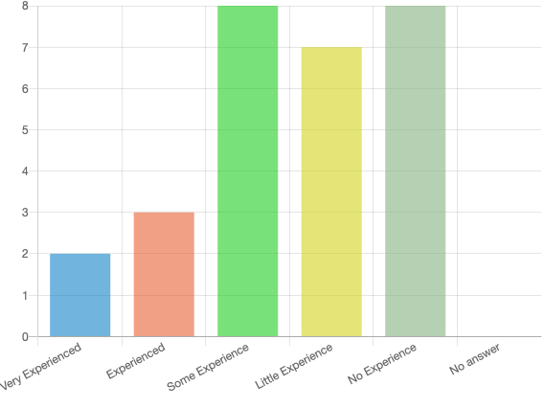
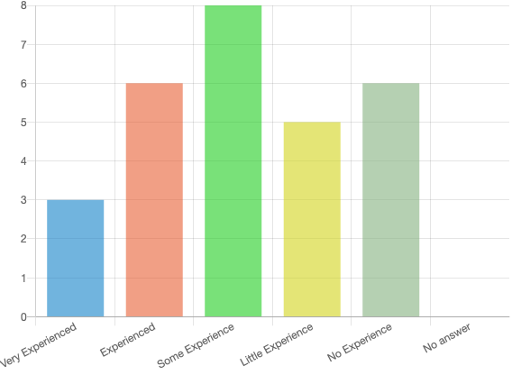
I ran a Anonymous survey.
What is your experience licensing OSS?
What is your experience contributing OSS?

Slide 10
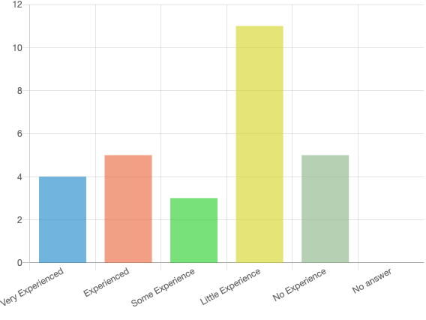
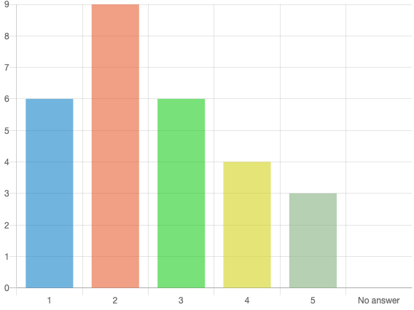
I ran a Anonymous survey.
What is your experience Distributing OSS?
OSS Resources and Documentation - You know where to go to find out information about how your organization deals with Open Source?
1 Needs Improvement 3 Average 5 Great

Slide 11
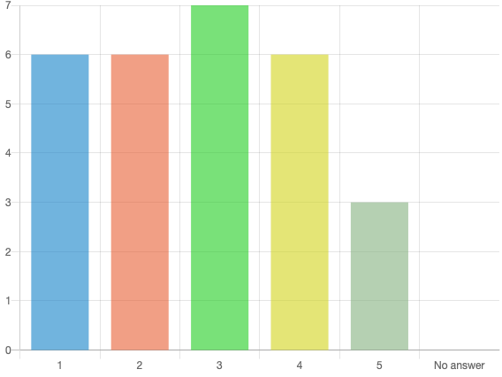
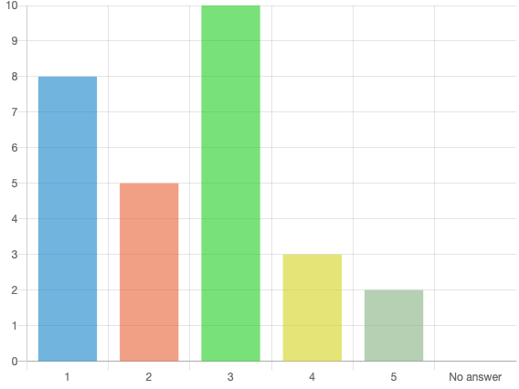
I ran a Anonymous survey.
OSS Personal Guidance - You know who to talk to at your organization?
OSS Defined Process, Policy, and Best Practices - You know how the organization wants your Open Source project to look?
1 Needs Improvement 3 Average 5 Great
1 Needs Improvement 3 Average 5 Great

Slide 12
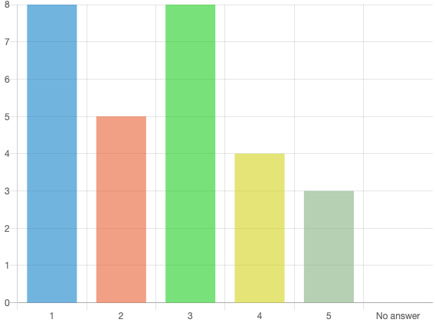
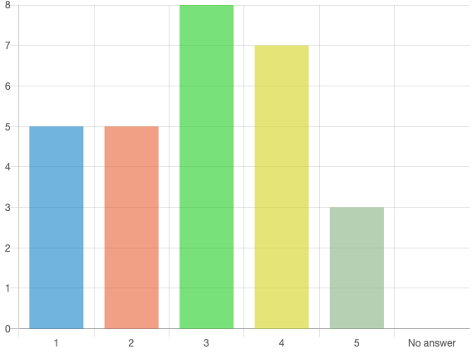
I ran a Anonymous survey.
OSS Marketing - You know that when you Open Source a project users will know how to find it?
OSS Useability - You know that when you Open Source projects, users can leverage it?
1 Needs Improvement 3 Average 5 Great
1 Needs Improvement 3 Average 5 Great

Slide 13
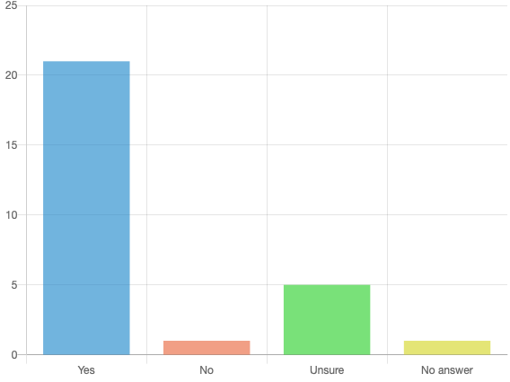
I ran a Anonymous survey.
Do you see value in an Open Source Project Office?
What we learned about FFRDC employees:
They have decent experience with consuming and creating OSS.
They somewhat understanding licensing
They do not know how the organization wants OSS releases or marketed.
They don’t always know where to get the OSS information they need.
After learning what a OSPO is they highly support the idea.
They appear qualified to evaluate their org.
Based off their initial responses I would make the assumption they believe their org OSS practices are possibly immature.

Slide 14
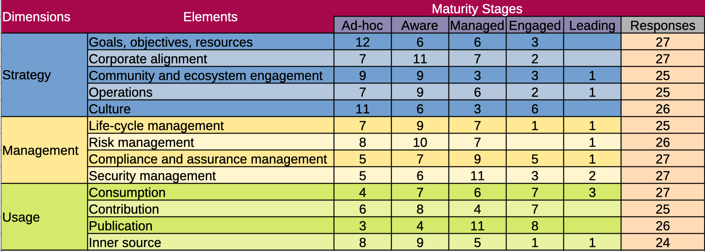
I ran a Anonymous survey.
Do you see value in an Open Source Project Office?
Created with
LibreOffice data
From LimeSurvey
Spreadsheet design influenced by
Open Source India and wipro Source Maturity Model

Slide 15
Survey - Maturity Stages
OSS Strategy leans immature.
Management leans mature.
Enterprise is firmly mature.
Created with LibreOffice Data From LimeSurvey

Slide 16
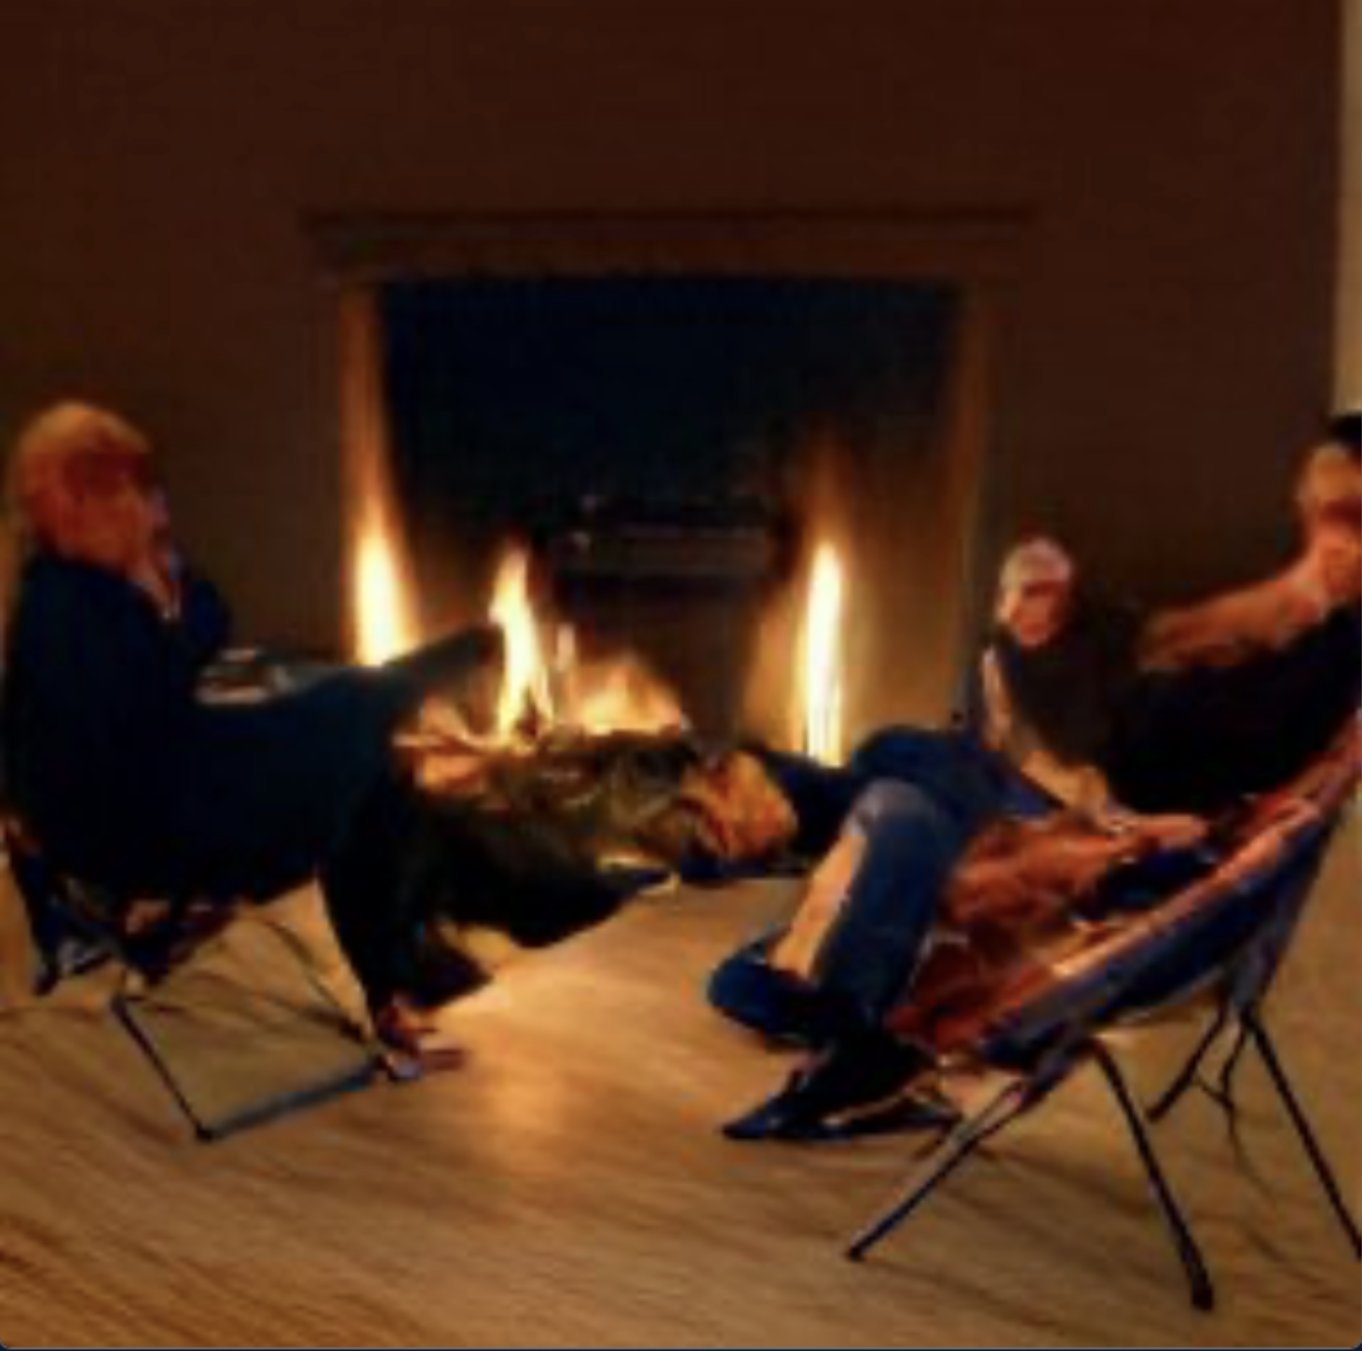
Survey - Maturity Stages
The community has spoken and they demand to be heard.
Anonymous interviews were conducted to get additional feedback than the survey could provide.
The interview was not meant to be a study with results, merely a way for me to better understand the survey results.
Image
created by
Craiyon

Slide 17

Stakeholder Interviews – IT
Believes that their org may not trust that OSS is as secure as COTTS/GOTTS, but has never been officially told that. No known official policies against the use of OSS at their org but believes InfoSec and IT may discourage the use of OSS without valid justification.
Believes some of their organizational users may work around IT policy to install OSS software becomes user manage policy.
No real QA process for OSS release.
Believes their organization could benefit from an OSPO.

Slide 18

Stakeholder Interviews - Engineer
Licensing challenges, it is up to me to have a license reviewed. In my org, a second review happens after the software is created which can cause changes.
Doesn't know if new features require additional review by their org.
Doesn't feel supported in creating OSS in their org.
Believes that If you open source software you have to maintain it. As a programmer I just want people to use my stuff. The community is important, and the point of OSS.
Analytics from repos help drive personal motivation and satisfaction.
Doesn't work on outside OSS projects anymore and doesn't think it would count towards career advancement in their org.
Image
created by
Craiyon

Slide 19

Stakeholder Interviews - Researcher
Follows ABC – Adopt, Buy, Create
Checks licensing and don't want to fall in love with code they ultimately they cant use.
Hates software with licenses designed to extract additional revenue that does not provide additionally needed features.
Runs licenses by ethics and compliance/legal before integrating OSS.
Does not know the internal process for release approval of OSS in their org.
Does not know if resources are available for OSS release quality assurance in their org.
Unsure if their org wants them to be an active member in the OSS community.
Unsure if an OSPO could be successful in their org.
Image
created by
Craiyon

Slide 20
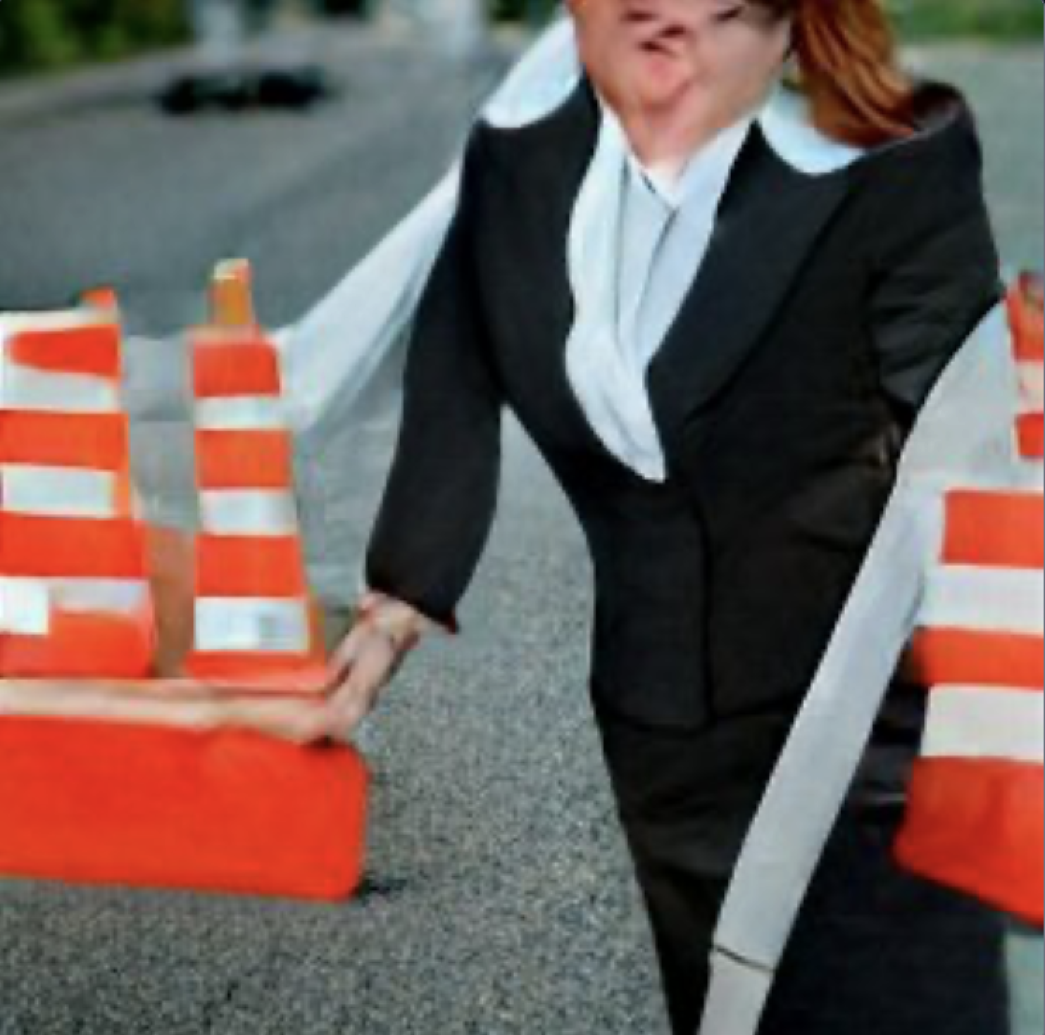
Stakeholder Interviews – Review and Approval
!!!!NOT TO BE CONSIDERED LEGAL ADVICE
Starts with reviewing your organization their terms and agreements with its sponsors to ensure you are not violating any information disclosure causes.
When you use other software with varying licenses it is good practice to have your legal department review the terms of licenses to make sure you can comply with them.
After your organization approves it, it may have to go to your organizations funding sponsor to clear for open release.
After it is approved by all parties you should be good to publish
Any updates to the project may require additional review. Check with your organization.
Collaboration activity can be viewed as a conflict of interest, check with your org.
Super Nice BTW.
Image
created by
Craiyon

Slide 21

Stakeholder Interviews - OSS Expert
A, B, and C as well as security concerns are your due diligence, long-term project, and willingness to maintain it.
Believes OPSOs are popular at most small and large companies but does not see a specific need for an OSPO at all organizations.
Likes the ideas of OPSO++ traditional OSPO which creates a substrate for boarding addition groups
Just because you create a great application doesn't mean it will inspire collaboration
Believes FFRDCS prefers to operate in Silos
Believes Linux best practices badges don't necessarily match the scorecard
Believes without evidence the maturity level is pointless
Believes that to incentive OSS contributions, they must be notable contributions that can be relevant to a DoD mission priority.
Review and Approval are important. If something goes wrong jobs could be at stake, CYA
Image
created by
Craiyon

Slide 22

What have we learned...
I believe the survey confirms most FFRDCs have mature OSS polices shaped by the restrictions of its sponsorship governance.
Non FFRDCs have a greater opportunity for OSS collaboration but a OSS community is what you make of it.
employees want to actively participate withing the OSS community.
The DoD openly encourages OSS.
FFRDCs mission aligns with transition software by open sourcing.
The way a FFRDC is structured makes it difficult to participate in the OSS community the same way nonprofits and for profit companies can.
A lack of OSS process transparency causes confusion and unfair immaturity labeling.
I believe FFRDC OSS polices are mature but that does not mean there is not room for improvement.
Professor Wasserman said I most likely couldn’t get everything I wanted done in a six week class and he was right.
For more detailed information please visit the GitHub OSS-FFRDC-Maturity https://github.com/daross-ai/OSS-FFRDC-Maturity
Image
created by
Craiyon

Slide 23

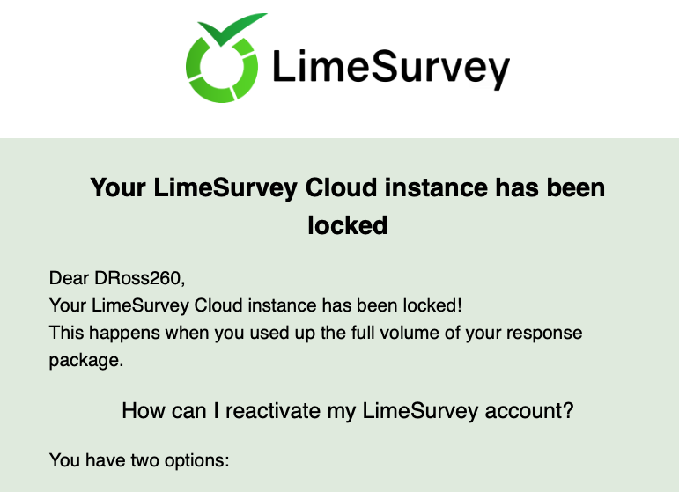
Dom’s OSS Mind Blowers!
GIF created
with GIMP
Paying for software in 2022 is kinda hard to justify.
Limesurvey locks you out of the platform if you exceed 25 responses on a free account. I thought it just stopped allowing users to post.
The DoD advertises Support of Open Source. My entire career I was told they were against it.
I prefer LibreOffice to MS Office.
Gimp is pretty good, unless you are a professional there is no reason to buy photoshop.
A OSS survey can really bring out the frustration.
The OSS community is strong and passionate.
My iMac in 2000 ran VM’s better than my Macbook

